Slide 1
Evolve academy shopping list
Point add up to pennies; pennies amount to pounds!
Safe
Right place
Engaged
Respectful
Uniform

Slide 2
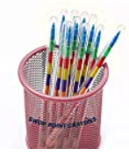
30 points and over
30 points
40 points
30 points
40 points

Slide 3
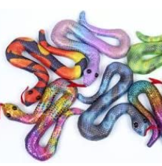
50 points and over
60 points
50 points
50 points
70 points
60 points

Slide 4
100 points and over
200 points
170 points
150 points
100 points
200 points

Slide 5
200 points and over
500 points
300 points
400 points
300 points
450 points
200 points

